Slide 1
Ames Housing Price Analysis
Mary, Jess, Sarah, Galen

Slide 2
Overview
Project Objective: | Investigate factors driving house prices in Ames, Iowa
Data: | Kaggle dataset for Ames Housing
Methods: | Analysis Tableau analysis Cluster analysis Machine Learning price prediction model Tech Host data on S3 Model in Colab Develop a website to make predictions from user input

Slide 3
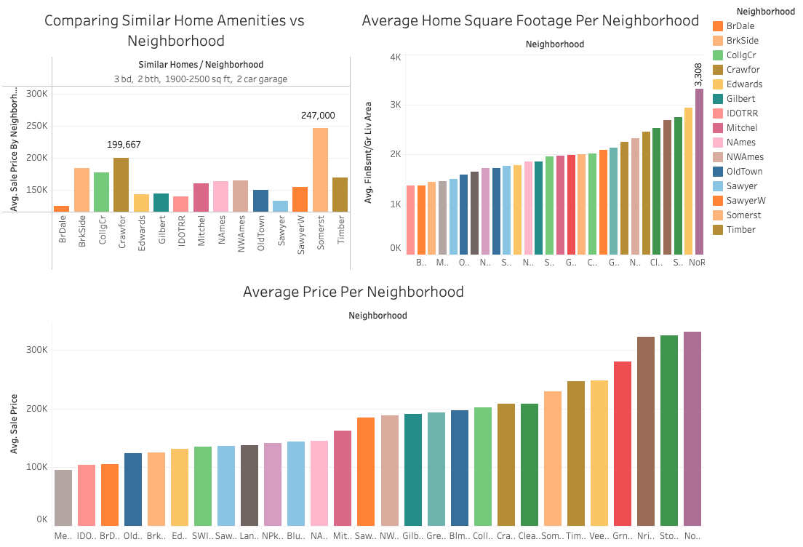
Results – Data Visualization
Various factors that typically drive home prices were viewed in a Tableau dashboard
Neighborhood data provided some interested initial insights:
Sqft / $ relationships
Amenities
https://public.tableau.com/app/profile/mary.hills/viz/AmesHousingData_16929331848960/NeighborhoodData

Slide 4
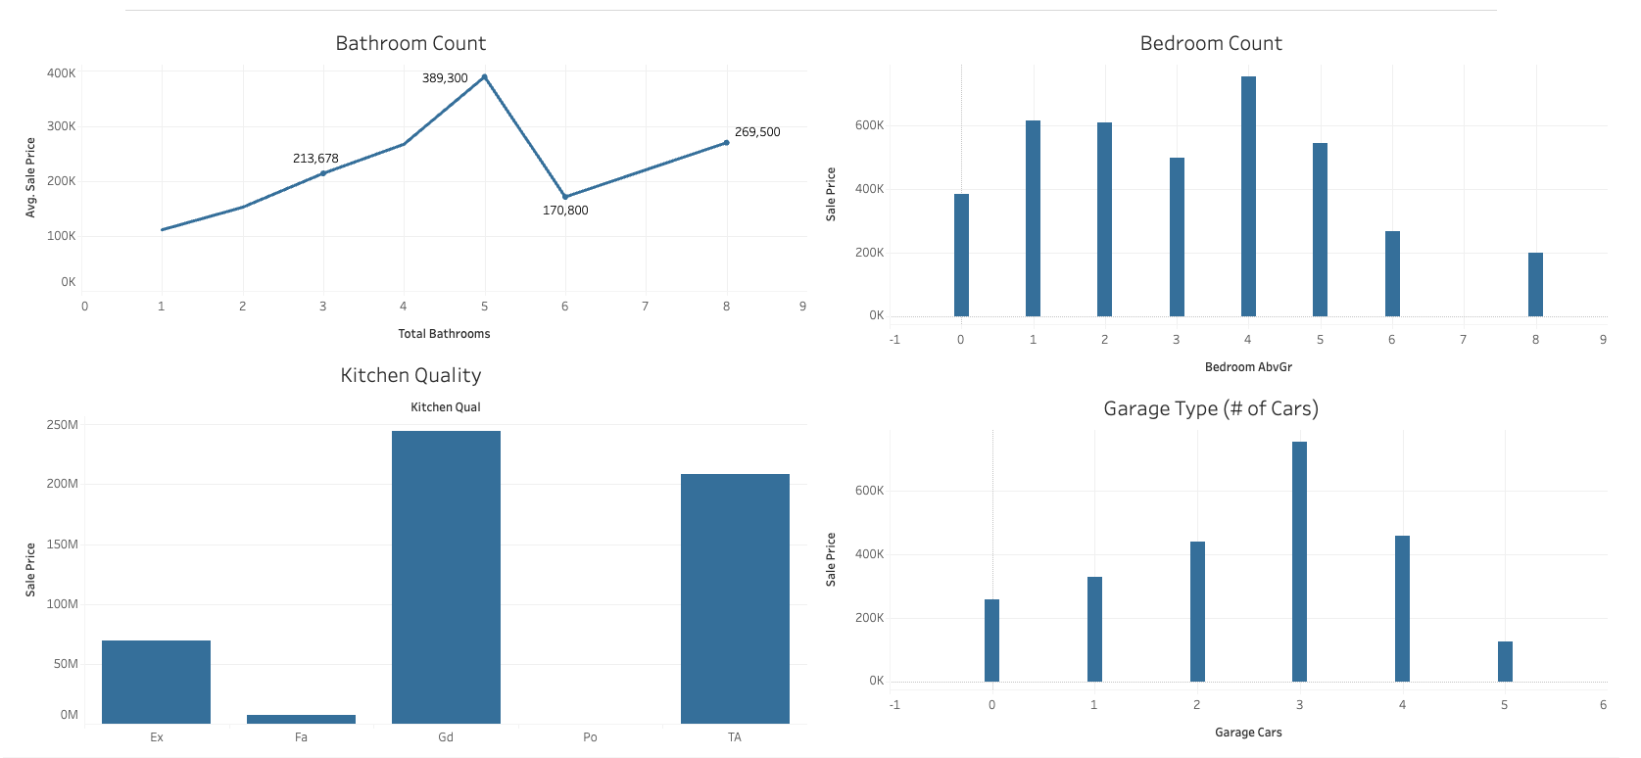
Results – Data Visualization
Amenities do not show strong relationships with price
https://public.tableau.com/app/profile/mary.hills/viz/AmesAmenitiesComparison/AmenitesComparison

Slide 5
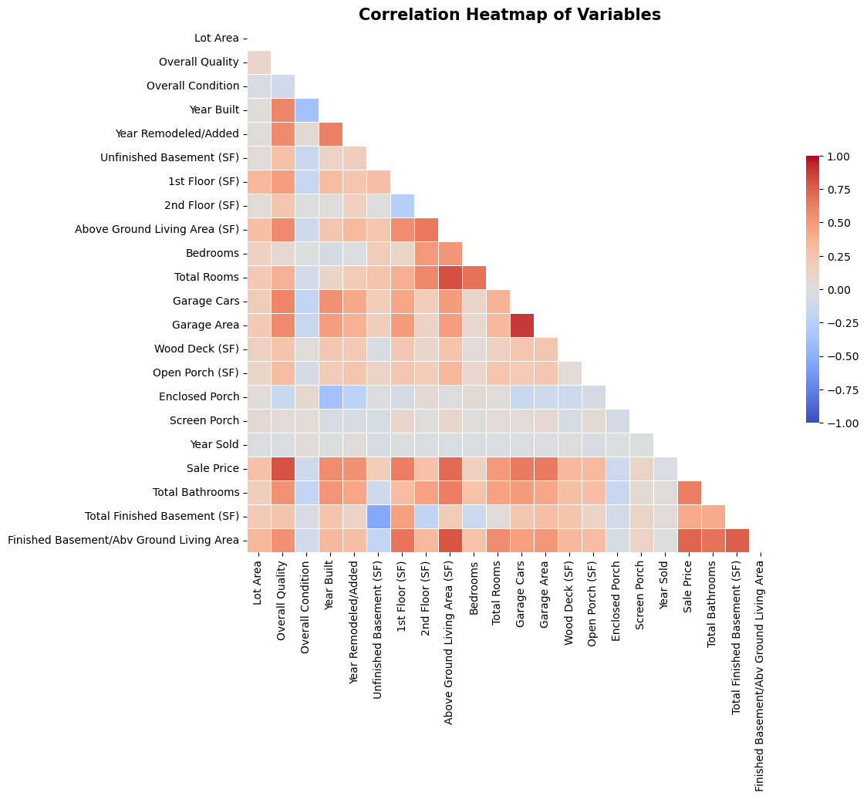
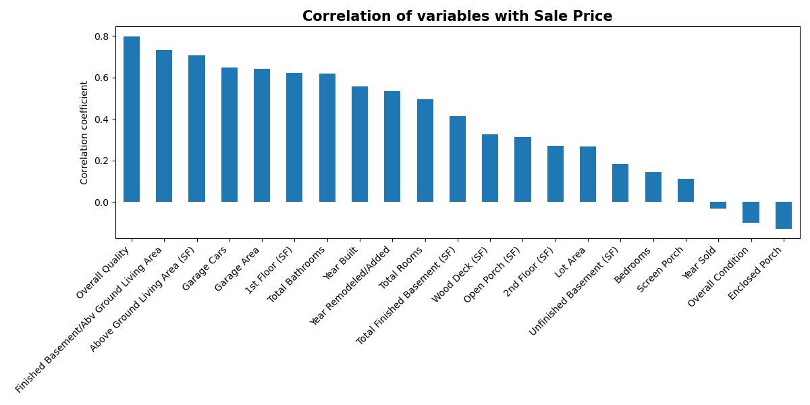
Results – Feature Correlations
Square footage & similar features (room count, floor space) appears strongly correlated to price on visual inspection
Amenities are clearly weaker

Slide 6
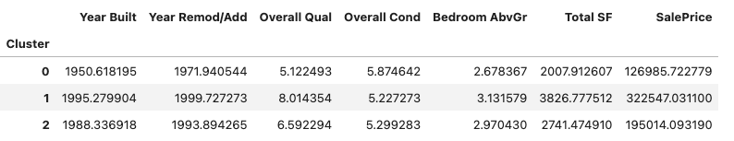
Results - Clustering
Price and condition appeared to be clearly visible strong elements in our cluster analysis
Total SF and year built & Overall Quality are correlated
Our clusters reflect age, which reflects size

Slide 7
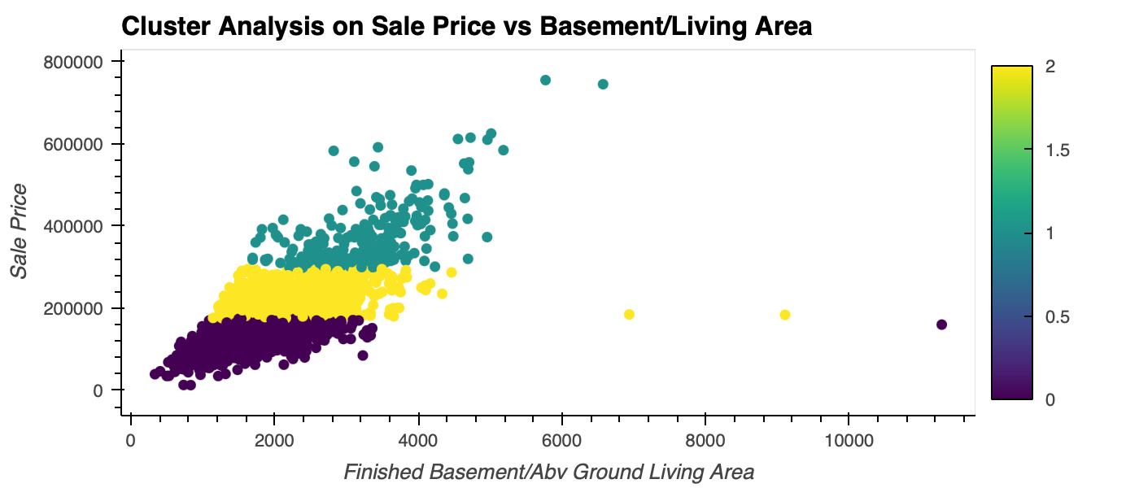
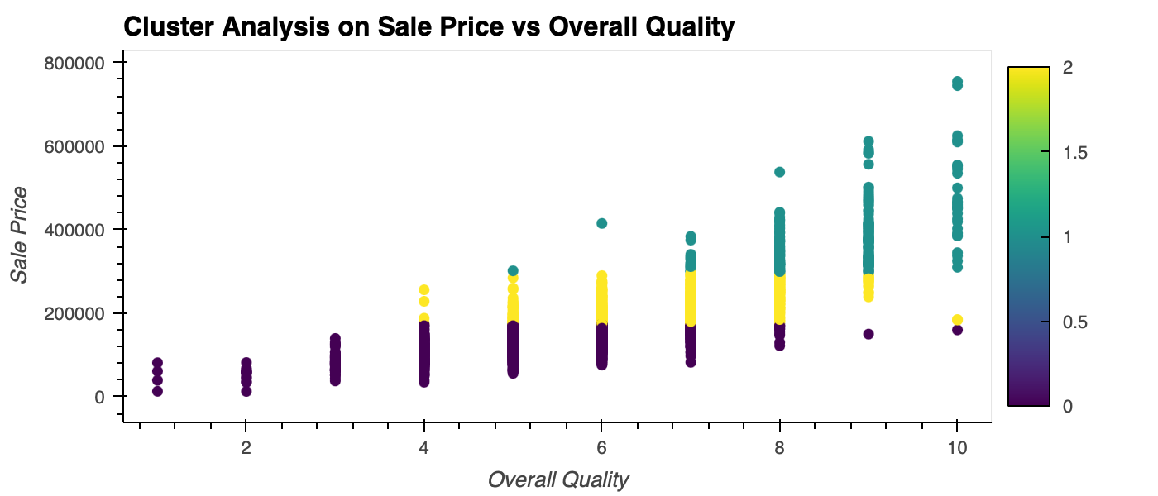
Results - Clustering
Overall quality and home size are key in clusters

Slide 8
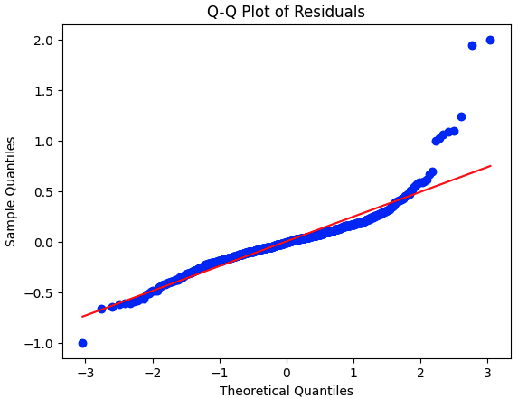
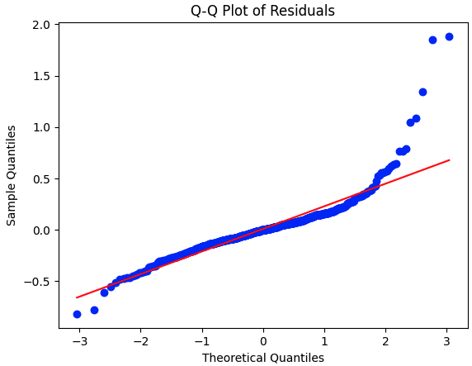
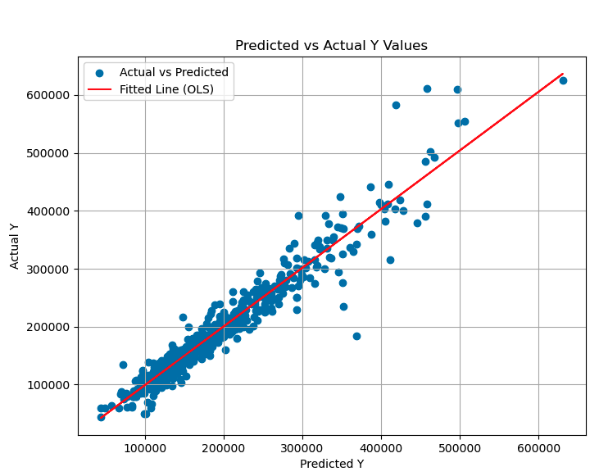
Results - Modeling
Trained Linear Regression & Gradient Boosting
Q-Q plots suggest there is an interaction or variable not accounted for in the model; overall good fit
Linear Regression was powerful out of the box, more complex models only gave marginal gains
Linear Regression
Gradient Boosting
Training R-Squared: 0.9401
Testing R-Squared: 0.9397
Mean Squared Error: 0.0695
Best Parameters: {'learning_rate': 0.1, 'loss': 'huber', 'max_depth': 3, 'n_estimators': 200, 'subsample': 1.0}
Training R-Squared: 0.9676501961674518
Testing R-Squared: 0.9501703258657423
Mean Squared Error: 0.05743137013095087

Slide 9
Results – Model Features
The model is primarily driven by quality elements and size elements of the home.
Other features that contribute are ones we already saw correlate with those two core features.
Feature Names | Feature Importances
Overall Qual | 0.39272483495402866
Total SF | 0.3568763700410612
Year Built | 0.045396744133224295
Year Remod/Add | 0.022098346479286855
Gr Liv Area | 0.0193034148646336
Kitchen Qual_TA | 0.017791286766306636
Garage Cars | 0.016039563131456474
BsmtFin SF 1 | 0.012385942230966514
Garage Area | 0.011932867284658226
Lot Area | 0.011541017959086157
Fireplaces | 0.009578511945560421
Overall Cond | 0.007511069312884516
Kitchen Qual_Gd | 0.006048403740001757
Central Air_Y | 0.0040168705378818

Slide 10
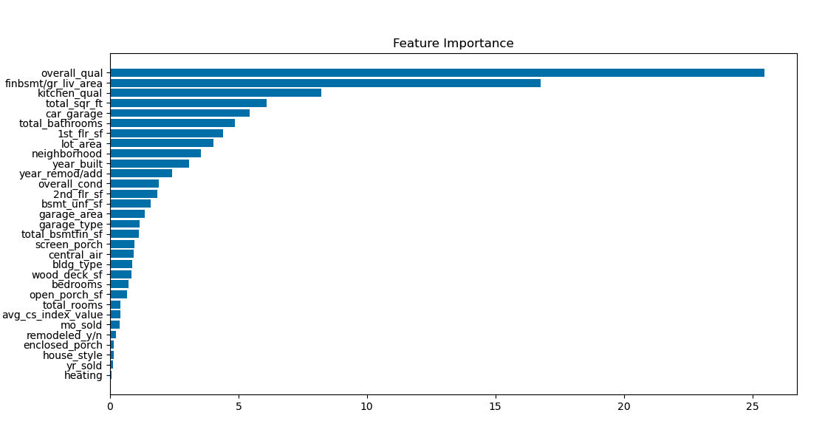
Results – Model Features - CatBoost
We re-ran the model using CatBoost for use in the web app inferencing, and it gave similar results
CatBoost gave r-squared of 0.92… not the best performing model, but the least to deploy in real life in our app

Slide 11
Demo Time
Predictions Webpage
Report Webpage

